Slide 1
Preparing for the black swans of resistance
David Livermore
Professor of Medical Microbiology, UEA

Slide 2
Disclosures
Consult / advisory – Accelerate, Achaogen, Allecra, Antabio, BioVersys, Centauri, Entasis, McKinsey, Meiji, Merck, Mutabilis, Nordic, ParaPharma, QPEX, Shionogi, Spero, TAXIS, TAZ, Tetraphase, VenatoRx, Wockhardt, Zambon
Lectures – Accelerate, Astellas, bioMerieux, Correvio, Beckman-Coulter, Cepheid, Nordic, Merck/MSD, Pfizer
Sponsored research – Meiji, Melinta, Merck, Pfizer, Roche, Tetraphase, VenatoRx, Wockhardt
Shareholdings – Dechra, GSK, Merck, Perkin Elmer, Pfizer amounting to <10% of portfolio value

Slide 3
And occasionally I’m asked to foretell the future
Brokers & marketing divisions want to project sales, asking
What % of Klebsiella will have carbapenemases in 2020?
Will KPC go up as ESBLs did after 2003?
‘Will KPC spread in the UK, Germany, France like in Italy?
UK Dept of Health Elicitation, ‘roulette method’ with 10 chips to spread on a probability scale in response to questions
‘Do I think pan-resistant gram-negatives will emerge? Persist? Accumulate? By how much? In 5 or 20 years?
The easy response is to extrapolate past trends into the future
Grigore et al. BMC Med Res Med 2016;16:85; Carter et al. Antibiotics 2017; 7: pii E9

Slide 4
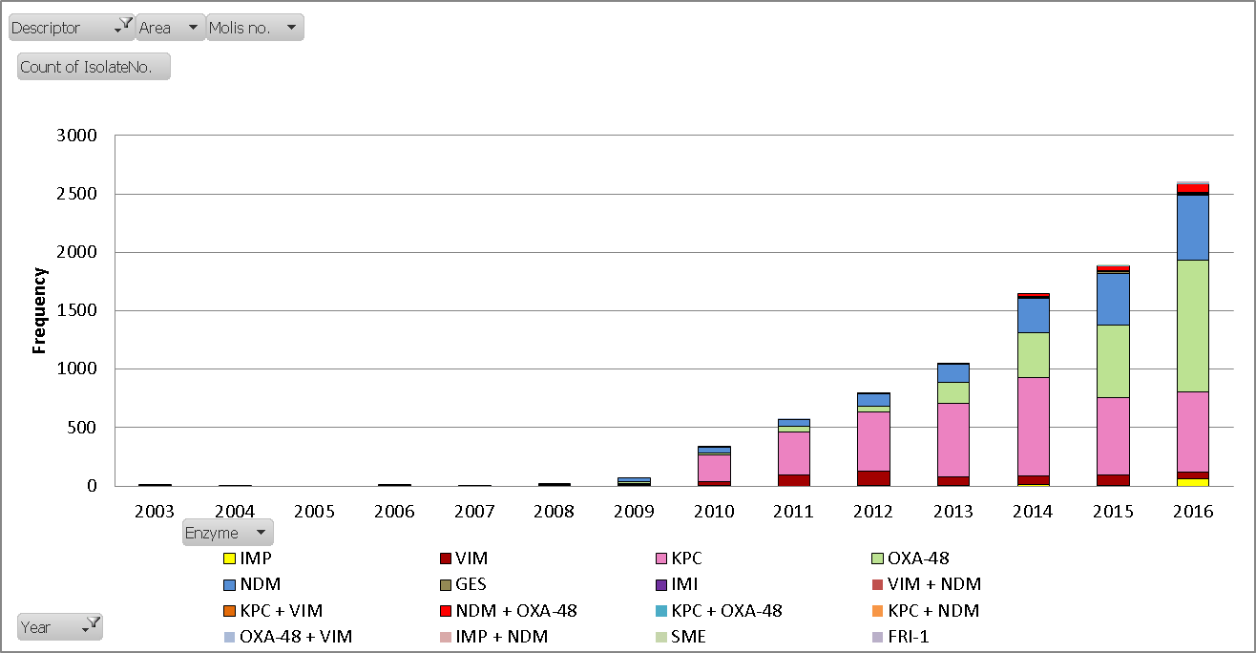
Carbapenemase producing Enterobacteria referred to PHE
AMRHAI, unpublished data

Slide 5
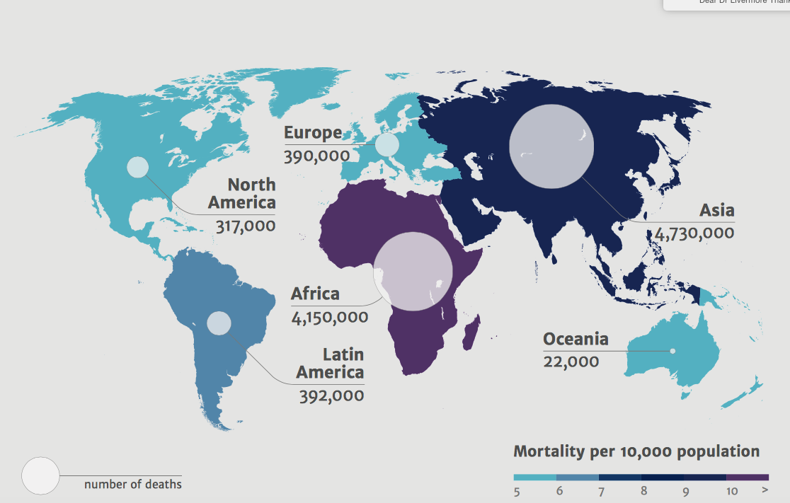
Deaths due to antimicrobial resistance by 2050
https://amr-review.org/

Slide 6
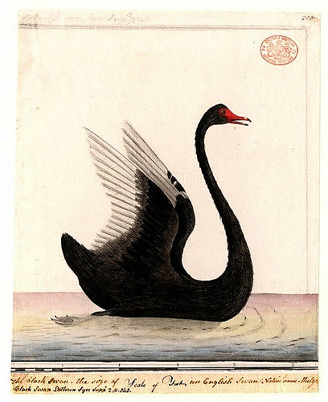
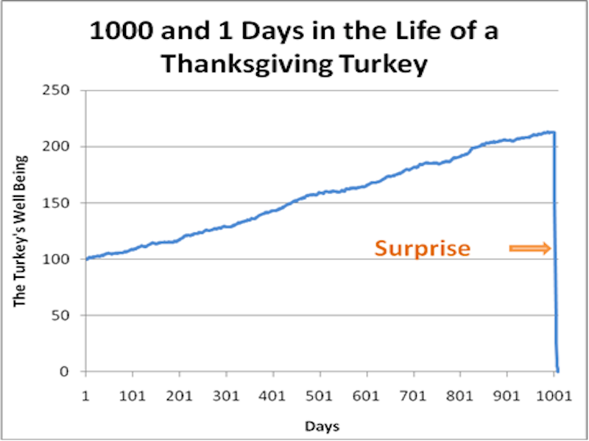


Black Swans

Slide 7
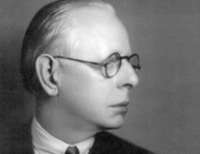
Jesse Livermore, Bethlehem Steel, & the Lusitania Break, 1915
‘War Speciality Stock’; steel & shipbuilding
7 Apr – Breaks $87 –previous high - nears $100 ‘trigger’ point
8 Apr – Buys 500 at $98 to $99; price runs to $117
      13 Apr –$145, ‘Had my stake’
      Not going to make fortune on 500 shares’
      Uses shares as collateral to buy more
7 May – Steel at $159… Germany U-boat torpedoes Lusitania
8 May - $130….. ‘got me in the solar plexus’
LeFevre / Livermore, Reminiscences of a Stock Operator, 1923
Livermore, How to Trade Stocks, Duell, Sloan Pearce, 1940
Preston , Wilful Murder, Sinking of the Lusitania, Random House 2011

Slide 8
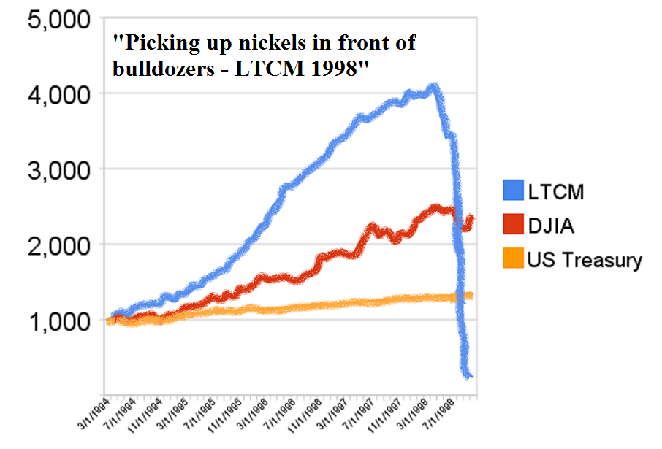
Long-Term Capital Management
2 Nobel laureates in economics on the board
Exploited pricing anomalies between long- & short-dated bonds
Anomalies are tiny, so need to borrow heavily & invest huge sums
Caught out when Asian financial crisis of 1998 fundamentally changed the relative pricing of long and short dated securities

Slide 9
How bacterial evolution proceeds
Periods of accumulation; reflects use/infection control
Mutant selection; predictable, reflects usage
AmpC mutants in cephalosporin R_{x} of Enterobacter infection
Imipenem R_{x} of P. aeruginosa infection
Escape of new genes to mobile DNA; unpredictable
Black swan events
Occasional massive shifts– if the ‘new’ mobile gene spread or associates with ‘fit’ clone(s)

Slide 10
Gene escapes that changed the rules
Before |  | Reached | Source
1961 | mecA | S. aureus | Rare Staph spp.
1965 | bla_{TEM} | Enterobacteriaceae / other G-ves | ???
 | erm | Staph and Strep | Streptomyces
Various | aac, aph, ant, ArmA | All | Streptomyces
1986 | VanA/VanB | Enterococci (Staph)
1987 | bla_{CTX-M} | Enterobacteriaceae | Kluyvera
1997 | bla_{KPC} | Enterobacteriaceae / other G-ves | ???
1990s | bla_{OXA-23} | A. baumannii | A. radioresistens
1999 | bla_{OXA-48} | Enterobacteriaceae / other G-ves | Shewenella
2006 | bla_{NDM} | Enterobacteriaceae / other G-ves | ???
2011 | mcr1 | Enterobacteriaceae | Moraxella?
Partridge FEMS Micro Revs; 2011;35:820; Canton CMI 2009; 15:20; Xavier et al., EuroSurv 2016;21; 7 July

Slide 11
3-gen ceph resistance in bloodstream E. coli, PHE
Proliferation largely of E. coli ST131 with CTX-M-15
E .coli with TEM exposed to lots of cephs, but ESBL E. coli stay rare
Updated from Livermore IJAA 2012;39:283

Slide 12
More black swans over 40 years
Fit MRSA…. (UK epidemic MRSA 15 and 16)
E. coli and gonococci with high-level fluoroqinolone resistance
Community MRSA
OXA carbapenemases in A. baumannii
Emergence of successful transferable carbapenemases
K. pneumoniae ST258 with KPC carbapenemases
Ceftazidime-avibactam resistance via increased affinity of KPC enzymes for ceftazidime, NOT reduced affinity for avibactam
Livermore et al. AAC 2015;59:5324; Livermore IJAA 2012;39:283

Slide 13
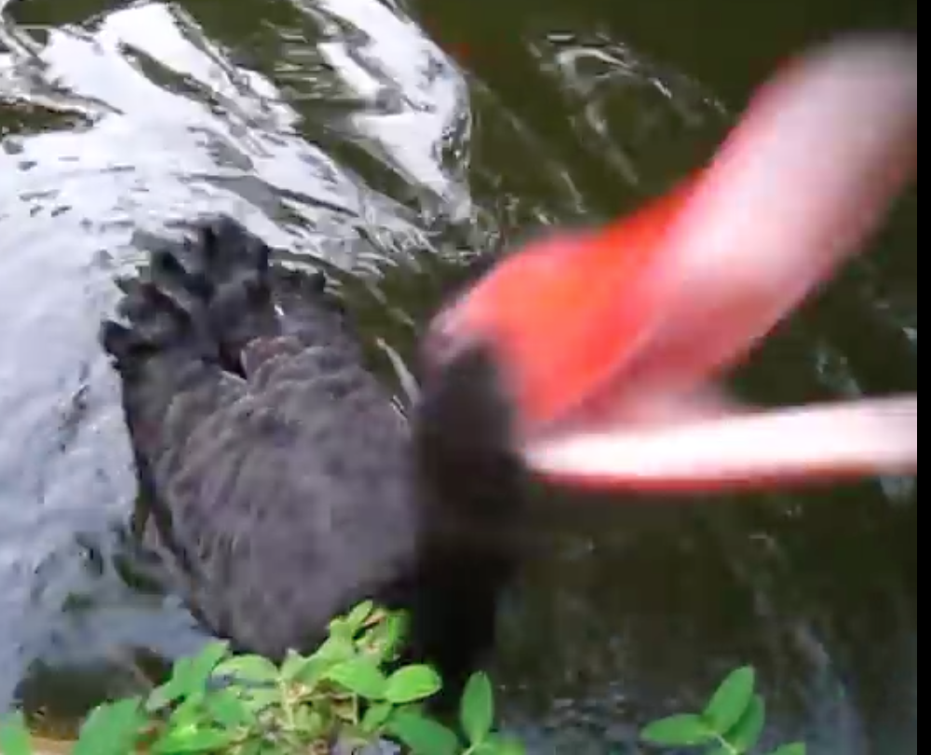
Black swans that’ve bitten me
Early years teaching … ‘Vancomycin attacks a substrate, not an enzyme,’ so you won’t get resistance
2 Post doc years, studying impermeability in P. aeruginosa, which turned out to be efflux

Slide 14
We rationalise what did happen; but history could have unfolded differently
We know what resistance genes have escaped
We don’t know all those that haven’t but could have done
Nor if they’ll escape in future…
We know what DID happen, 1914-18 War
Franz Ferdinand shot in Sarajevo; route through town had been changed after first assassination attempt, driver not told
Suppose driver had followed the correct route; what then?
Churchill, Hitler fought on Western Front and survived
Suppose either hadn’t; what then?

Slide 15
What can we expect next
Some existing resistance up-trends will continue
Especially if antibiotic use is heavy & infection control poor
Stewardship and infection control will have successes
But infection control difficult if resistance has spread to community
Success of stewardship IN REDUCING RESISTANCE unpredictable
Resistance mutations to new β-lactamase inhibitor combos
And new black swans will take flight

Slide 16
MICs (mg/L) CAZ-AVI- bla_{KPC} mutants: avibactam combinations
Single & multi-step mutants (X+Y) | CAZ-AVI 4 mg/L |  | Ceftaroline –AVI 4 mg/L
 | Parent | Mutants | Parent | Mutants
Klebsiella
NCTC13438 (29+2) | 1 | 4-128 | 0.5 | 0.5-8
H…643 (24+6) | 1 | 8-128 | 1 | 0.5-4
Enterobacter
H…226 (28+5) | 0.5 | 4-128 | 0.5 | 1-8
H…216 (7+0) | 0.25 | 8-64 | 0.5 | 0.5-2
13/14 mutants sequenced had changes to bla_{KPC}, mostly around Ω loop
Livermore et al. AAC 2015;59:5324

Slide 17
Ceftazidime-avibactam vs. Carbapenem-R Enterobacteriaceae
University of Pittsburgh, consecutive CAZ-AVI patients
37 carbapenem-R; 31 with KPC; 31 Klebsiella
Various infections: 12 pneumonias, 10 bacteraemias
Clinical cure = 67%
90-day survival = 62%
Microbiological failure = 10 (27%)
3 KPC cases with resistance selected (MICs 64-128 mg/L)
Carmeli et al., LID 2016;16:661; Shields et al. CID 2016 epub

Slide 18
AmpC changes selected in ceftolozane/tazo R_{x}
 | PA105A | PA147A | 109-E9 | 110-G8 | 101-E5 | 103-H8
Ceftolozane-tazo | 1 | >64 | 2 | 32 | 2 | >32
Ceftazidime | 4 | >32 | 32 | 64 | 16 | 64
C’taz-avibactam | 4 | >32 | 4 | 32 | 4 | >32
Piperacillin/tazo | 16 | 64 | 64 | 16 | 64 | 32
Meropenem | 8 | 8 | 8 | 4 | 8 | 16
Imipenem | >32 | 1 | 16 | 2 | 16 | 4
Gentamicin | 2 | 8 | - | - | - | -
Ciprofloxacin | >8 | >8 | >32 | >32 | >32 | >32
Colistin | 1 | 1 | - | - | - | -
Rx for | Wound, 6 weeks |  | RTI, 2 weeks |  | RTI, 10 days
Change | Gly183Asp |  | Deletion 229-247 |  | Glu247Lys
MacVane et al. AAC 2017;61:e01183; Fraile-Ribot et al., JAC 2017 epub

Slide 19
Screening 480 soil streptomycetes
 | Resistant (n) | Tested for inactivation (n) | Able to inactivate (n)
Cephalexin | 442 | 16 | 3
Ciprofloxacin | 52 | 52 | 0
Clindamycin | 107 | 46 | 0
Daptomycin | 480 | 80 | 64
Erythromycin | 128 | 128 | 9
Novobiocin | 12 | 12 | 0
Rifampicin | 49 | 49 | 20
Synercid | 294 | 71 | 14
Telithromycin | 83 | 83 | 4
Trimethoprim | 478 | 80 | 0
Vancomycin | 5 | 5 | 0
D’Costa et al., Science 2006; 131:374

Slide 20
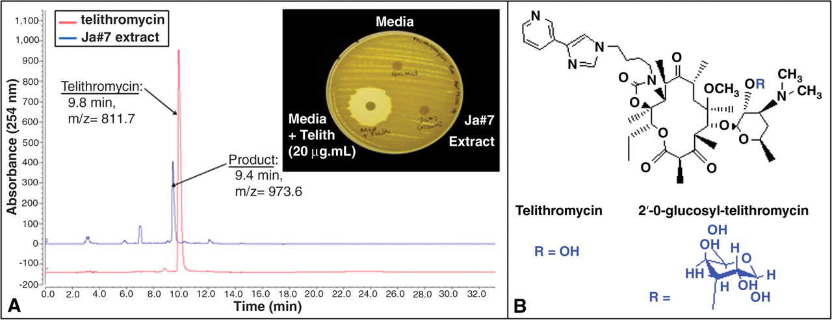
Glycosylation of telithromycin by a soil streptomycete
V M D'Costa et al. Science 2006;311:374

Slide 21
A critical’ escape would be a carbapenemase that became ‘comfortable’ in a fit E. coli strain
… like CTX-M-15 ESBL in ST131

Slide 22
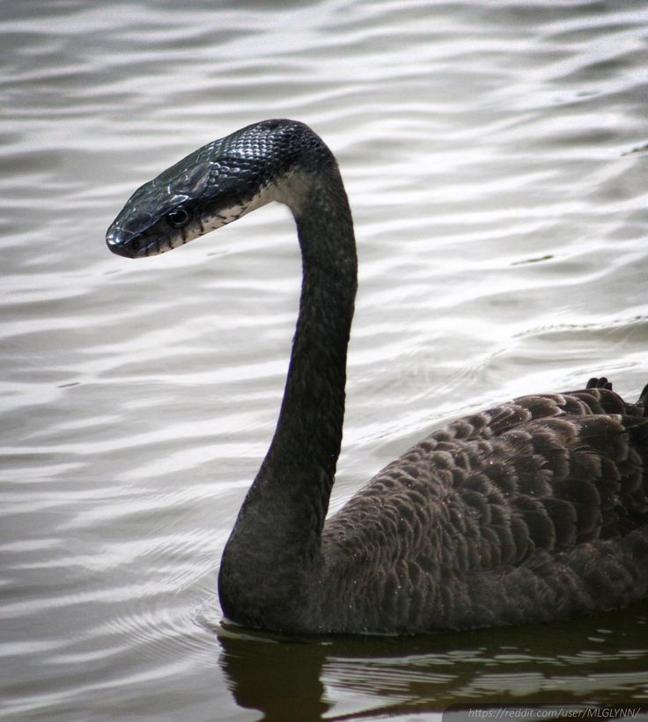

Slide 23
Altered, transferable PBP3…
NDM carbapenemase-producing E. coli with aztreonam/avibactam MICs 4-16 mg/L vs. <1 mg/L for ‘normal’ NDM E. coli
Insert of Tyr-Gly-Ile-Asn/Lys after amino acid 333 (Tyr-Gly-Ile-Asn is a duplication of normal sequence)
India, Turkey, Lebanon, Kuwait, China, Thailand
Multiple sequence types
β-Lactam (except carbapenem) MICs rose for lab constructs with insert
Some altered PBP3s had other consistent sequence abnormalities, suggesting horizontal transfer…….
Alm et al., JAC 2015; 70: 1420

Slide 24
UK ref lab sees 1-3 Klebsiella per week like this
 | MIC (mg/L) or behaviour
Cefotaxime | 2
Ceftazidime | 32
Cefepime | 64
Pip-tazo | >64
Ertapenem | >16
Imipenem/meropenem | 16
Aztreonam | 4
Ceph-clav synergy | No
Ceph-cloxacillin synergy | No
Carbapenem-EDTA synergy | No
Hodge bioassay with cephs or carbapenems | No activity seen
Genomic sequencing only found SHV-1 & porin loss
Convinced ourselves - efflux or permeability
Added ceftazidime-avibactam to panel… 16-fold synergy seen
Livermore et al. JAC 2018; 73: 648

Slide 25
O’Neill Commission – key recommendations on resistance
Public education
More use of diagnostics
Less use of antibiotics in agriculture
‘Market entry rewards’ for new antibiotics:
…..we need e.g. G20 to get together and reward developers of new antibiotics after approval for use……
…. c. $1 bn each given to the developers of successful new drugs, if not ‘over-marketed’ and yet available to patients who need them
……. Picking winners……
Paraphrased from https://amr-review.org/sites/default/files/160525_Final%20paper_with%20cover.pdf

Slide 26
Which ‘winner’ would you pick?
In the 1980s would you have rewarded:
    Cefotaxime – 100-fold lower MICs than earlier cephs
    Ceftriaxone – like cefotaxime but more convenient
    Ceftazidime – added P. aeruginosa to ceph. spectrum
    Cefsulodin – narrow-spectrum antipseudomonal
    Imipenem – AmpC/ESBL stable
    Aztreonam – MBL stable… unimportant then!
Best answers only clear in retrospect
………. & perception may change with time…

Slide 27
Which answer to the ‘MBL threat’ would you reward?
MBL-stable monobactam + BLI
  Aztreonam-avibactam
MBL-labile β-lactam + triple action diazabicyclooctane
  Cefepime-zidebactam; meropenem-nacubactam
MBL-labile β-lactam + boronate
  Cefepime-VNRX-5133
Broadly-β-lactamase (inc. MBL)- stable β-lactams
  Cefiderocol, monobactam LYS-228
And maybe MBLs don’t cause resistance so effectively in vivo?
Chibabhai et al., Infection 2018; 46 :1

Slide 28
In a world of change
Spread risk
Favour diversity
Don’t think you’re clever enough to pick winners
  Time and experience will choose them

Slide 29
Picking avibactam’s partner: ceftazidime or cefepime?
Ceftazidime favoured because:
Licensed, familiar, used in more countries
Lower MICs for P. aeruginosa
Published concerns of cefepime efficacy
Later deemed misplaced
Yahav et al., LID 2007; 7: 338
Kim et al. CID 2010; 51:381

Slide 30
Was ceftazidime the right partner choice?
Cefepime-AVI MICs 4-fold lower than CAZ-AVI
KPC enzyme mutate to become better ceftazidimases
Confer CAZ-AVI resistance
Cefepime MICs tend to fall, not to rise
AmpC can mutate in the lab, conferring CAZ-AVI-resistance
Cefepime is more stable to AmpC
Legace-Wiens et al. AAC 2010; 55: 2434; Livermore et al. AAC 2015; 59: 5324;
Livermore et al., JAC 2018, in press; MacVane et al. AAC 2017;61:e01183; Fraile-Ribot et al., JAC 2017 epub

Slide 31
‘Was ceftazidime the right partner’ = WRONG QUESTION
We are learning the threats to CAZ / AVI
We don’t know cefepime/AVI’s vulnerabilities…..
The rise of MBLs prompted devt of aztreonam / AVI
But aztreonam/AVI is 3-4 years behind CAZ/AVI
Meantimes docs co-administering aztreonam plus CAZ/AVI
Wenzler et al., DMID 2017; 88: 352
Jayol et al., JAC 2018; 73: 542
Shaw et al. JAC 2017; 73: 1104

Slide 32
A better model for β-lactamase inhibitors?
Once we know an inhibitor works in vivo and is safe from one large trial with one partner….
Then
  Small trials with multiple partners targeted on infections due to bacteria with relevant β-lactamases
  In 1980s, sulbactam licensed alone in Germany & France

Slide 33
Vancomycin & colistin
Vancomycin licensed 1955; colistin 1958
Vancomycin for endocarditis: 6-patient trial
Swiftly superseded by better / less toxic agents
Kept available despite minimal market
Kirst et al. AAC 1998;42:1303

Slide 34
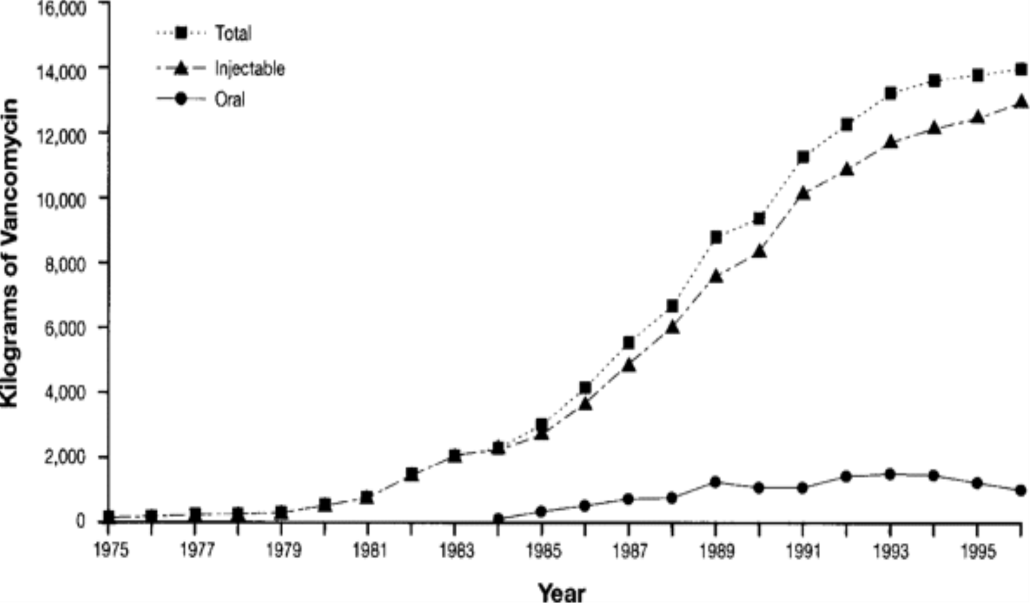
Vancomycin use, US, UK, France, Germany, Italy & Netherlands
I could highlight pick fosfomycin or colistin
Kirst et al. AAC 1998;42:1303
Notes:
Figure 2 Use of vancomycin in the United States, France, Italy, Germany, the United Kingdom, and The Netherlands. Reprinted from Kirst et al. [28] with permission from the American Society for Microbiology.
34

Slide 35
Agents that go nowhere for years
$1 bn Market entry rewards won’t go down well
    ‘Taxpayers funded never-used, toxic antibiotic’*
? Restricted license on limited trial data
? Longer patent
? Pay to keep available
Examples: quinupristin/dalfopristin; plazomicin; oritavancin
*Daily Mail. 1 April 2025

Slide 36
Arab proverb: He who predicts the future lies, even if he tells the truth
We know only that resistance will throw up new challenges
In a world of uncertainty, future robustness lies in diversity
Govts aren’t clever enough to reliably pick winners
Encourage innovation with early stage funding, spread widely
Adapt regulations to encourage multiple antibiotics to market
Favour small informative clinical trials vs. resistant pathogens
Restrictive licenses with long patents to encourage stewardship

Slide 37
Max Planck Inst for the Study of Societies Discussion Paper 16/6
Uncertainty and the Dangers of Monocultures in Regulation, Analysis, and Practice
Richard Bronk & Wade Jacoby
Uncertainty is endemic to innovative economies and complex societies, but policymakers underestimate how damaging this is for many of their guiding assumptions. In particular, the discourse of best practice, “global solutions for global problems,” and regulatory harmonization becomes questionable when there is substantial uncertainty about the future. This uncertainty makes it impossible to know what best practice will be and increases the danger that harmonization will result in highly correlated errors and shared analytical blind spots. The transnational harmonization of regulation has well-known advantages, but – especially in technocratic policy areas – also creates vulnerability to unexpected challenges by constraining how we think as well as homogenizing how we act. Faced with uncertainty, policymakers should be wary of monocultures in regulation, analysis, and practice, and instead focus on managing policy diversity to limit its costs.
http://www.mpi-fg-koeln.mpg.de/pu/mpifg_dp/dp16-6.pdf

